Slide 1
Basic UI controls
Windows Programming with WinUI

Slide 2
Quick start example

Slide 3
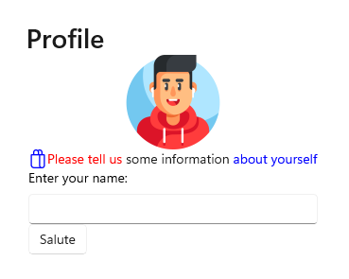
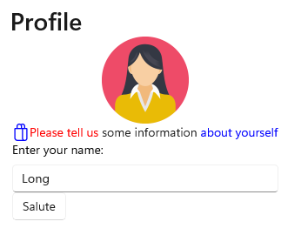
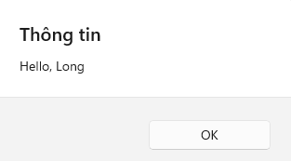
Simple screen
Notes:
<StackPanel Orientation="Vertical" HorizontalAlignment="Center" VerticalAlignment="Center">
<TextBlock Text="Profile" Style="{StaticResource TitleTextBlockStyle}"/>
<Image Name="avatarImage" Source="Assets/gamer.png" Width="100" Height="100" />
<StackPanel Orientation="Horizontal">
<SymbolIcon Symbol="Shop" Foreground="Blue"/>
<TextBlock >
<Run Text="Please tell us" Foreground="Red" /> some information <Run Text="about yourself" Foreground="Blue"/>
</TextBlock>
</StackPanel>
<TextBox Name="nameTextBox" Header="Enter your name:"/>
<Button x:Name="saluteButton" Click="saluteButton_Click">Salute</Button>
</StackPanel>
]
private async void saluteButton_Click(object sender, RoutedEventArgs e)
{
// Change avatar
var bitmap = new BitmapImage()
{
UriSource = new Uri("ms-appx:///Assets/woman.png")
};
avatarImage.Source = bitmap;
// Get the name and print out salutation message
string name = nameTextBox.Text;
string message = $"Hello, {name}";
var dialog = new ContentDialog()
{
XamlRoot = this.Content.XamlRoot,
Title = "Thông tin",
Content = message,
CloseButtonText = "OK"
};
var result = await dialog.ShowAsync(); // _ = dialog.ShowAsync();
}
// Cách 2:
<TextBlock Margin="10">
<Run Text="&#xE70F;" FontFamily="Segoe Fluent Icons"/>
<Run Text="Please tell us" Foreground="Blue"/> <Run Text="something"/><Run Text=" about yourself" Foreground="Red"/>
</TextBlock>

Slide 4
Things to consider
Window: Activated, Title, Width? Height?
StackPanel > Hot reload
TextBlock: Name, Text, Style, TextTrimming, Run
SymbolIcon / FontIcon
TextBox: Name, Text, Header
Button: Name, Content, Click
Image: Name, Source
Set image by code behind > Content
ContentDialog: Buttons

Slide 5
Exercises
1-6 Inspiring quotes
2-7 English vocabulary
3-8 Landmarks
4-9 Nation flags
5-0 Football players
Text/Image
Activated: display random 1 item
Next button: Go to the next random item.
Min prepare: 10 items.
Submission: 22115782_22761892_22456672.zip

Slide 6
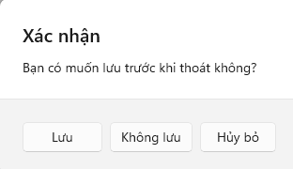
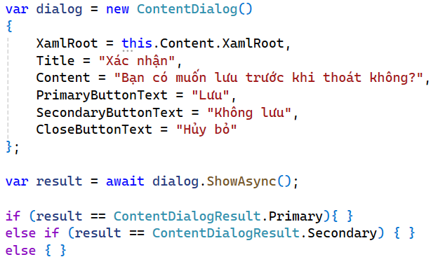
ContentDialog - Which button is clicked?

Slide 7
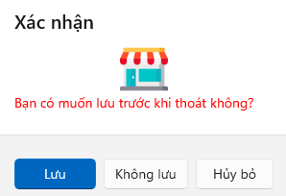
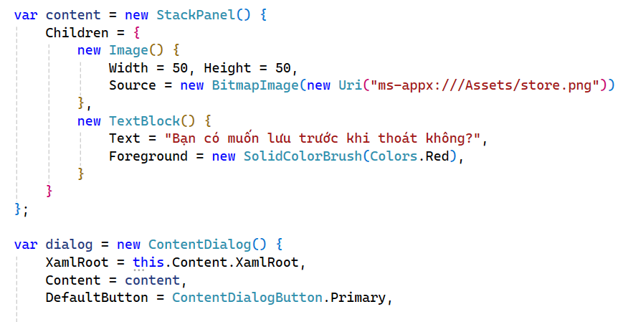
Content Dialog - Customize content

Slide 8
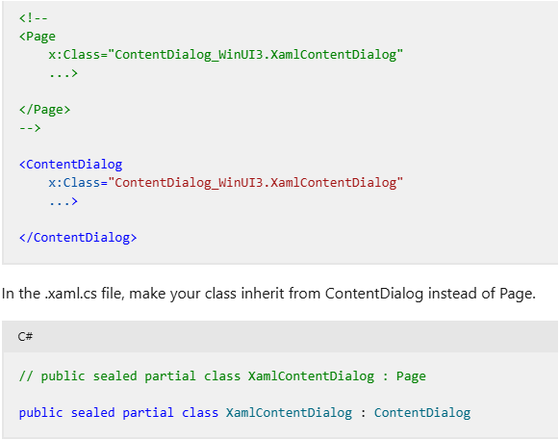
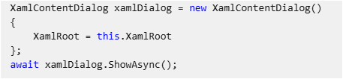
Load from external xaml Page file
Dialog controls - Windows apps | Microsoft Learn
Notes:
<?xml version="1.0" encoding="utf-8"?>
<ContentDialog x:Class="DemoDatabinding.ConfigDialog"
xmlns="http://schemas.microsoft.com/winfx/2006/xaml/presentation"
xmlns:x="http://schemas.microsoft.com/winfx/2006/xaml"
xmlns:local="using:DemoDatabinding"
xmlns:d="http://schemas.microsoft.com/expression/blend/2008"
xmlns:mc="http://schemas.openxmlformats.org/markup-compatibility/2006"
mc:Ignorable="d" IsPrimaryButtonEnabled="False" CloseButtonText="OK">
<ContentDialog.TitleTemplate>
<DataTemplate>
<StackPanel Orientation="Horizontal">
<TextBlock Text="Config"/>
</StackPanel>
</DataTemplate>
</ContentDialog.TitleTemplate>
<StackPanel>
<TextBlock Text="Things to config"/>
</StackPanel>
</ContentDialog>
var dialog = new ConfigDialog();
dialog.XamlRoot = this.XamlRoot;
_ = dialog.ShowAsync();

Slide 9
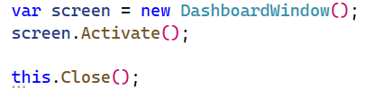
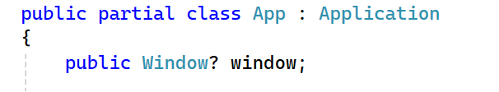
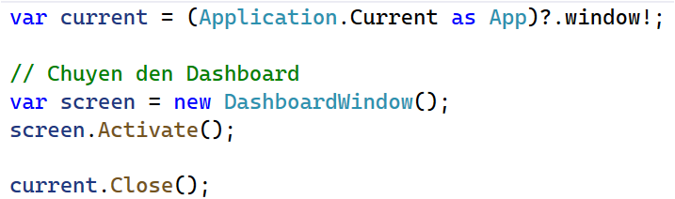
Display another window
c# - How to retrieve the window handle of the current WinUI 3 MainWindow from a page in a frame in a NavigationView control on the MainWindow - Stack Overflow

Slide 10
Display multiple windows - Frame & Page
Frame has a lot of Page (s)

Slide 11
Passing data between frames
Frame.Navigate(Type.GetType("Test.DashboardPage"), data);
override void OnNavigatedTo
e.Parameter

Slide 12
Getting input

Slide 13
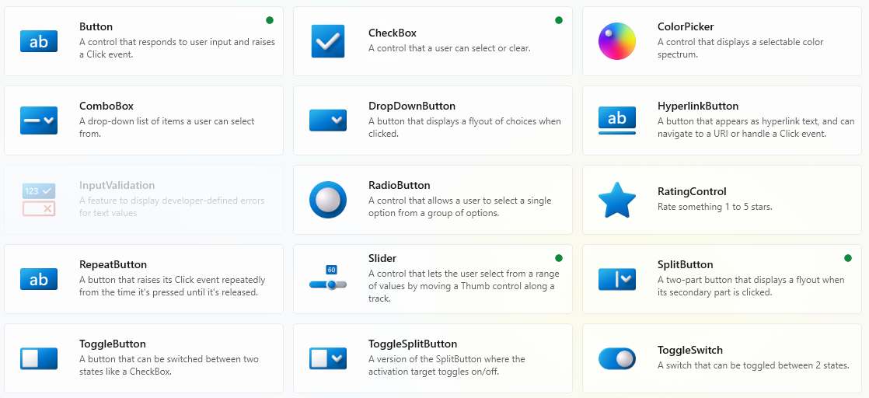
WinUI Gallery Basic input

Slide 14
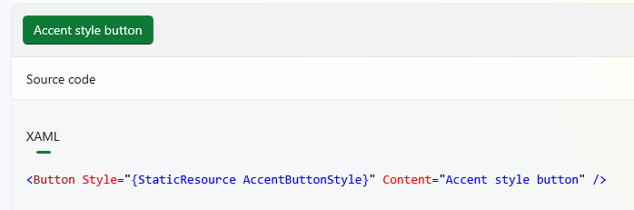
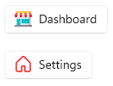
Button
Image inside button
SymbolIcon inside button
Notes:
<Button Name="dashboardButton" Margin="10">
<StackPanel Orientation="Horizontal">
<Image Width="20" Height="20" Margin="0, 0, 8, 0" Source="Assets/store.png"/>
<TextBlock Text="Dashboard"/>
</StackPanel>
</Button>
<Button Name="settingsButton" Margin="10">
<StackPanel Orientation="Horizontal">
<SymbolIcon Symbol="Home" Margin="0, 0, 8, 0" Foreground="Red"/>
<TextBlock Text="Settings"/>
</StackPanel>
</Button>

Slide 15
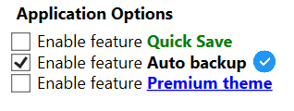

CheckBox
IsChecked (true / false / null) / IsThreeState
Checked / UnChecked / Indeterminate
Check boxes - Windows apps | Microsoft Learn

Slide 16
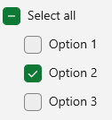
Exercise - Checkbox combination

Slide 17
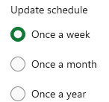
RadioButton
RadioButtons: Header
IsChecked / IsThreeState
Checked / Unchecked / Indeterminate
Guidelines for radio buttons - Windows apps | Microsoft Learn

Slide 18
Other type of button
HyperlinkButton
DropdownButton
Slider
ProgressBar / ProgressRing
ToggleButton

